Slide 1


Introduction to Computer Science
Reichman University
Lecture 4-2
Arrays, Part II
How Java Manages Arrays and Strings:
A Low-Level Perspective
Notes:
1

Slide 2
How Java handles strings
high-level abstraction
low-level implementation
...
RAM
...
...

Slide 3
How Java handles strings
high-level abstraction
low-level implementation
...
int n = 100;
String s = "zehu";
RAM
...
...

Slide 4
How Java handles strings
high-level abstraction
low-level implementation
...
int n = 100;
String s = "zehu";
RAM
...
n
10
100
s
"zehu"
...

Slide 5
How Java handles strings
high-level abstraction
low-level implementation
...
int n = 100;
String s = "zehu";
s = s + 'z';
RAM
...
n
10
100
s
"zehu"
...

Slide 6
How Java handles strings
high-level abstraction
low-level implementation
...
int n = 100;
String s = "zehu";
s = s + 'z';
RAM
...
n
10
100
s
"zehu"
"zehuz"
...

Slide 7
How Java handles strings
high-level abstraction
low-level implementation
...
int n = 100;
String s = "zehu";
s = s + 'z';
s = s + 'e';
RAM
...
n
10
100
s
"zehu"
"zehuz"
...

Slide 8
How Java handles strings
high-level abstraction
low-level implementation
...
int n = 100;
String s = "zehu";
s = s + 'z';
s = s + 'e';
RAM
...
n
10
100
s
"zehu"
"zehuz"
...
"zehuze"

Slide 9
How Java handles strings
high-level abstraction
low-level implementation
...
int n = 100;
String s = "zehu";
s = s + 'z';
s = s + 'e';
System.out.println(s); // zehuze
s = s.replace('z', 'm');
RAM
...
n
10
100
s
"zehu"
"zehuz"
...
"zehuze"

Slide 10
How Java handles strings
high-level abstraction
low-level implementation
...
int n = 100;
String s = "zehu";
s = s + 'z';
s = s + 'e';
System.out.println(s); // zehuze
s = s.replace('z', 'm');
System.out.println(s); // mehume
...
RAM
...
n
10
100
s
"zehu"
"zehuz"
...
"zehuze"
"mehume"

Slide 11
How Java handles strings
high-level abstraction
low-level implementation
...
int n = 100;
String s = "zehu";
s = s + 'z';
s = s + 'e';
System.out.println(s); // zehuze
s = s.replace('z', 'm');
System.out.println(s); // mehume
...
RAM
...
n
10
100
s
"zehu"
Reclaimed by Java’s Garbage Collector
"zehuz"
...
"zehuze"
"mehume"
Garbage Collector
A process that runs in the runtime’s background (part of the the JRE)
Collects “orphan” objects (arrays, strings, …) that have no variables pointing at them
Recycles the memory held by these objects.

Slide 12
How Java handles arrays
high-level abstraction
low-level implementation
...
int n = 100;
int[] a = {1, 2, 3};
// Returns the elements of arr, reversed
public static int[] reverse(int[] arr) {
// Code omitted
}
...
RAM
...
10
...

Slide 13
How Java handles arrays
high-level abstraction
low-level implementation
...
int n = 100;
int[] a = {1, 2, 3};
// Returns the elements of arr, reversed
public static int[] reverse(int[] arr) {
// Code omitted
}
...
RAM
...
n
10
100
a
1 2 3
...

Slide 14
How Java handles arrays
high-level abstraction
low-level implementation
...
int n = 100;
int[] a = {1, 2, 3};
a = reverse(a);
// Returns the elements of arr, reversed
public static int[] reverse(int[] arr) {
// Code omitted
}
...
RAM
...
n
10
100
a
1 2 3
...

Slide 15
How Java handles arrays
high-level abstraction
low-level implementation
...
int n = 100;
int[] a = {1, 2, 3};
a = reverse(a);
// Returns the elements of arr, reversed
public static int[] reverse(int[] arr) {
// Code omitted
}
...
RAM
...
n
10
100
a
1 2 3
3 2 1
...

Slide 16
How Java handles arrays
high-level abstraction
low-level implementation
...
int n = 100;
int[] a = {1, 2, 3};
a = reverse(a);
...
int[] b = a;
// Returns the elements of arr, reversed
public static int[] reverse(int[] arr) {
// Code omitted
}
...
RAM
...
n
10
100
a
1 2 3
3 2 1
...

Slide 17
How Java handles arrays
high-level abstraction
low-level implementation
...
int n = 100;
int[] a = {1, 2, 3};
a = reverse(a);
...
int[] b = a;
// Returns the elements of arr, reversed
public static int[] reverse(int[] arr) {
// Code omitted
}
...
RAM
...
n
10
100
a
1 2 3
b
3 2 1
...

Slide 18
How Java handles arrays
high-level abstraction
low-level implementation
...
int n = 100;
int[] a = {1, 2, 3};
a = reverse(a);
...
int[] b = a;
b[1] = 8;
// Returns the elements of arr, reversed
public static int[] reverse(int[] arr) {
// Code omitted
}
...
RAM
...
n
10
100
a
1 2 3
b
3 2 1
...

Slide 19
How Java handles arrays
high-level abstraction
low-level implementation
...
int n = 100;
int[] a = {1, 2, 3};
a = reverse(a);
...
int[] b = a;
b[1] = 8;
// Returns the elements of arr, reversed
public static int[] reverse(int[] arr) {
// Code omitted
}
...
RAM
...
n
10
100
a
1 2 3
b
3 8 1
...

Slide 20
How Java handles arrays
high-level abstraction
low-level implementation
...
int n = 100;
int[] a = {1, 2, 3};
a = reverse(a);
...
int[] b = a;
b[1] = 8;
System.out.println(a[1]); // 8
...
// Returns the elements of arr, reversed
public static int[] reverse(int[] arr) {
// Code omitted
}
...
RAM
...
n
10
100
a
1 2 3
dangerous code
b
3 8 1
...

Slide 21
How Java handles arrays
high-level abstraction
low-level implementation
...
int n = 100;
int[] a = {1, 2, 3};
a = reverse(a);
...
int[] b = a;
b[1] = 8;
System.out.println(a[1]); // 8
...
// Returns the elements of arr, reversed
public static int[] reverse(int[] arr) {
// Code omitted
}
...
RAM
...
n
10
100
a
1 2 3
b
3 8 1
...
Recap
String variables and array variables are references (contain addresses)
Arrays: Changes to the array elements remain “in place” (within the same memory block)
String: Changes to the string result in creating a new string (a new memory block).

Slide 22



Introduction to Computer Science
Shimon Schocken
IDC Herzliya
Lecture 4-2
Arrays, Part III
Arrays in action: Application examples
Notes:
22

Slide 23

Application example: Coupon collector problem
Example
There are 100 different baseball cards.
Each cereal box contains one card.
How many cereal boxes do you have to buy until you collect all 100 cards?
N
% java CouponCollector 100
587
% java CouponCollector 100
538
% java CouponCollector 100
580
Coupon collector problem
How many times do you have to draw random integers between 0 and N-1 until every integer has been drawn at least once?

Slide 24
Coupon collector problem
Algorithm
found = boolean array[0, ..., N-1] // all false
count = 0
nDistinct = 0 // Counts how many distinct values where drawn so far
while nDistinct < N
draw a random int r from 0 to N-1
count++
if found[r] is false:
found[r] = true
nDistinct++
return count
// And hope that the loop will terminate…
N
% java CouponCollector 100
587
% java CouponCollector 100
538
% java CouponCollector 100
580
Coupon collector problem
How many times do you have to draw random integers between 0 and N-1 until every integer has been drawn at least once?

Slide 25
Coupon collector problem: implementation
// Computes How many times you have to draw random integers between
// 0 and N-1 until all integers 0,1,2 ,…, N-1 have been drawn
public class CouponCollector {
public static void main(String[] args) {
int N = Integer.parseInt(args[0]);
int count = 0; // number of values drawn so far
int nDistinct = 0; // number of distinct values drawn so far
boolean[] found = new boolean[N];
for (int i = 0; i < N; i++) found[i] = false;
// Runs the simulation (note: this loop may never terminate)
while (nDistinct < N) {
// Draws a random integer between 0 and N-1, and updates the relevant counters
int val = (int) (Math.random() * N);
count++;
if (found[val] == false) {
found[val] = true;
nDistinct++;
}
}
// All the numbers between 0 and N-1 have been collected!
System.out.println(count);
}
}
N
% java CouponCollector 100
587
% java CouponCollector 100
538
% java CouponCollector 100
580

Slide 26
Coupon collector: Experiment
N
T: number of trials
% java CCExperiment 2 10
Average number of trials to obtain 2 values: 2.8
% java CCExperiment 2 10
Average number of trials to obtain 2 values: 5.1
% java CCExperiment 2 10
Average number of trials to obtain 2 values: 4.0

Slide 27
Coupon collector: Experiment
N
T: number of trials
% java CCExperiment 2 10
Average number of trials to obtain 2 values: 2.8
% java CCExperiment 2 10
Average number of trials to obtain 2 values: 5.1
% java CCExperiment 2 10
Average number of trials to obtain 2 values: 4.0
% java CCExperiment 2 1000000
Average number of trials to obtain 2 values: 2.998388
% java CCExperiment 2 1000000
Average number of trials to obtain 2 values: 3.002255
% java CCExperiment 2 1000000
Average number of trials to obtain 2 values: 2.997449
N = 10,
high variance
N = 100000,
low variance
Example of the “Law of Large Numbers”

Slide 28
Coupon collector: Experiment
public class CCExperiment {
// Computes how many times you have to draw random integers between 0 and N-1 until every integer has been drawn
public static int couponCollector(int N) {
int count = 0; // number of values drawn so far
int nDistinct = 0; // number of distinct values drawn so far
boolean[] found = new boolean[N];
for (int i=0; i<N; i++) found[i] = false;
// Runs the simulation
while (nDistinct < N) {
// Draws a random integer between 0 and N-1 and updates // the relevant counters
int val = (int) (Math.random() * N);
count++;
if (!found[val]) {
nDistinct++;
found[val] = true;
}
}
// All the values between 0 and N-1 have been collected!
return count;
}
% java CCExperiment 2 10 // 10 = number of trials
Average number of trials to obtain 2 values: 2.8
% java CCExperiment 2 10
Average number of trials to obtain 2 values: 5.1
% java CCExperiment 2 10
Average number of trials to obtain 2 values: 4.0
% java CCExperiment 2 1000000
Average number of trials to obtain 2 values: 2.998388
% java CCExperiment 2 1000000
Average number of trials to obtain 2 values: 3.002255
% java CCExperiment 2 1000000
Average number of trials to obtain 2 values: 2.997449

Slide 29
Coupon collector: Experiment
public class CCExperiment {
public static void main(String[] args) {
final int N = Integer.parseInt(args[0]); // number of values (“final”: cannot be mutated)
final int T = Integer.parseInt(args[1]); // number of trials
double sum = 0;
for (int t = 0; t < T; t++) {
sum = sum + couponCollector(N);
}
System.out.println("Average number of trials to obtain " + N + " values: " + sum / T );
}
// Computes how many times you have to draw random integers between 0 and N-1 until every integer has been drawn
public static int couponCollector(int N) {
int count = 0; // number of values drawn so far
int nDistinct = 0; // number of distinct values drawn so far
boolean[] found = new boolean[N];
for (int i=0; i<N; i++) found[i] = false;
// Runs the simulation
while (nDistinct < N) {
// Draws a random integer between 0 and N-1 and updates // the relevant counters
int val = (int) (Math.random() * N);
count++;
if (!found[val]) {
nDistinct++;
found[val] = true;
}
}
// All the values between 0 and N-1 have been collected
return count;
}
% java CCExperiment 2 10 // 10 = number of trials
Average number of trials to obtain 2 values: 2.8
% java CCExperiment 2 10
Average number of trials to obtain 2 values: 5.1
% java CCExperiment 2 10
Average number of trials to obtain 2 values: 4.0
% java CCExperiment 2 1000000
Average number of trials to obtain 2 values: 2.998388
% java CCExperiment 2 1000000
Average number of trials to obtain 2 values: 3.002255
% java CCExperiment 2 1000000
Average number of trials to obtain 2 values: 2.997449

Slide 30
Application example: The thinning of the primes

Slide 31
The thinning of the primes
Prime: an integer > 1 whose only positive factors are 1 and itself.
The thinning of the primes:
The primes between 1 and 20: 2, 3, 5, 7, 11, 13, 17
The primes between 980 and 1000: 983, 991, 997
The primes between 9980 and 10000: none
Observation: As we go further along the number line, the primes seem to thin out (though they never run out)
How can we check this hypothesis?
Write a program that counts how many primes there are up to N.

Slide 32
Algorithm for finding all the primes up to N (Sieve of Eratosthenes )
initialize: build an array of size N and set all its values to true:
0
1
2
3
4
5
6
7
8
9
10
11
12
13
14
15
16
17
18
19
…
isPrime
T
T
T
T
T
T
T
T
T
T
T
T
T
T
T
T
T
T
T
T
…
Mark all the multiples of 2:
0
1
2
3
4
5
6
7
8
9
10
11
12
13
14
15
16
17
18
19
…
isPrime
F
T
F
T
F
T
F
T
F
T
T
T
T
T
F
T
F
T
F
T
…
Mark all the multiples of 3:
0
1
2
3
4
5
6
7
8
9
10
11
12
13
14
15
16
17
18
19
…
isPrime
F
T
F
T
F
F
F
T
F
T
T
T
T
T
F
T
F
T
F
F
…
Mark all the multiples of 5 (the next number which was not yet crossed out):
0
1
2
3
4
5
6
7
8
9
10
11
12
13
14
15
16
17
18
19
…
isPrime
F
T
F
T
F
F
F
T
F
T
T
T
T
T
F
T
F
T
F
F
…
When done: the indexes of the surviving true entries (greater than 1) are primes:
0
1
2
3
4
5
6
7
8
9
10
11
12
13
14
15
16
17
18
19
…
isPrime
F
T
F
T
F
F
F
T
F
T
T
T
T
T
F
T
F
T
F
F
…
output:
11
13
17
0
1
2
3
5
7
19
…

Slide 33
Sieve of Eratosthenes: implementation
public class PrimesCounter {
public static void main(String[] args) {
final int N = Integer.parseInt(args[0]);
// Put your code here
}
}
% java PrimesCounter 25
2 is prime
3 is prime
5 is prime
7 is prime
11 is prime
13 is prime
17 is prime
19 is prime
23 is prime
The number of primes up to 25 is 9 (36% are prime)

Slide 34
The thinning of the primes
Hypothesis
As we go further along the number line, the primes thin out (become more and more rare)
% java PrimesCounter 100
The number of primes up to 100 is 25 (25% are prime)
% java PrimesCounter 1000000
The number of primes up to 1000000 is 78498 (8% are prime)
% java PrimesCounter 1000000000
The number of primes up to 1000000000 is 50847534 (5% are primes)
Conclusion
The experiment seems to support the hypothesis.

Slide 35
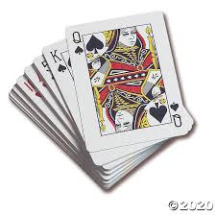

Application example: Shuffling
Tasks
Building a deck of cards
Shuffling a deck of cards

Slide 36
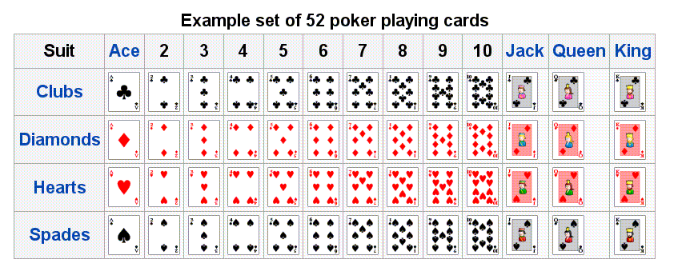
Building a deck of cards
public class Deck {
public static void main(String[] args) {
// Builds a deck of cards
String[] rank = {"2", "3", "4", "5", "6", "7", "8", "9",
"10", "Jack", "Queen", "King", "Ace"};
String[] suit = {"Clubs", "Diamonds", "Hearts", "Spades"};
...
% java Deck
2 of Clubs
2 of Diamonds
2 of Hearts
2 of Spades
3 of Clubs
3 of Diamonds
3 of Hearts
3 of Spades
4 of Clubs
4 of Diamonds
4 of Hearts
4 of Spades
5 of Clubs
5 of Diamonds
...
Ace of Clubs
Ace of Diamonds
Ace of Hearts
Ace of Spades
4 of Hearts
Builds and prints a deck of cards,
then selects and prints a random card
rank
0 1 2 3 4 ...
0
suit
1
2
3

Slide 37
Building a deck of cards
public class Deck {
public static void main(String[] args) {
// Builds a deck of cards
String[] rank = {"2", "3", "4", "5", "6", "7", "8", "9",
"10", "Jack", "Queen", "King", "Ace"};
String[] suit = {"Clubs", "Diamonds", "Hearts", "Spades"};
String[] deck = new String[52];
for (int i = 0; i < rank.length; i++)
for (int j = 0; j < suit.length; j++)
deck[4 * i + j] = rank[i] + " of " + suit[j];
% java Deck
2 of Clubs
2 of Diamonds
2 of Hearts
2 of Spades
3 of Clubs
3 of Diamonds
3 of Hearts
3 of Spades
4 of Clubs
4 of Diamonds
4 of Hearts
4 of Spades
5 of Clubs
5 of Diamonds
...
Ace of Clubs
Ace of Diamonds
Ace of Hearts
Ace of Spades
4 of Hearts
rank
0 1 2 3 4 ...
0
suit
1
2
3

Slide 38
Building a deck of cards
public class Deck {
public static void main(String[] args) {
// Builds a deck of cards
String[] rank = {"2", "3", "4", "5", "6", "7", "8", "9",
"10", "Jack", "Queen", "King", "Ace"};
String[] suit = {"Clubs", "Diamonds", "Hearts", "Spades"};
String[] deck = new String[52];
for (int i = 0; i < rank.length; i++)
for (int j = 0; j < suit.length; j++)
deck[4 * i + j] = rank[i] + " of " + suit[j];
// Prints the deck
for (int i = 0; i < 52; i++) {
System.out.println(deck[i]);
}
System.out.println();
// Selects and prints a random card
System.out.println(deck[(int) (Math.random() * 52)]);
...
% java Deck
2 of Clubs
2 of Diamonds
2 of Hearts
2 of Spades
3 of Clubs
3 of Diamonds
3 of Hearts
3 of Spades
4 of Clubs
4 of Diamonds
4 of Hearts
4 of Spades
5 of Clubs
5 of Diamonds
...
Ace of Clubs
Ace of Diamonds
Ace of Hearts
Ace of Spades
4 of Hearts

Slide 39
Shuffling
% java Deck
10 of Diamonds
King of Spades
2 of Spades
3 of Clubs
4 of Spades
Queen of Clubs
2 of Hearts
7 of Diamonds
6 of Spades
Queen of Spades
3 of Spades
Jack of Diamonds
6 of Diamonds
8 of Spades
9 of Diamonds
...
6 of Spades
% java Deck
3 of Clubs
6 of Diamonds
3 of Spades
Jack of Hearts
8 of Spades
4 of Spades
2 of Hearts
7 of Diamonds
6 of Spades
10 of Diamonds
King of Spades
2 of Spades
3 of Spades
Jack of Diamonds
6 of Diamonds
...
4 of Diamonds
% java Deck
5 of Clubs
Jack of Hearts
9 of Spades
10 of Spades
9 of Clubs
7 of Spades
6 of Diamonds
7 of Hearts
7 of Clubs
5 of Spades
4 of Spades
Queen of Diamonds
5 of Diamonds
Jack of Clubs
Ace of Hearts
...
10 of Hearts
Each time you run this program, it outputs a shuffled deck of cards
Notes:
Knuth shuffle more sophisticated than it appears
introduce swap idiom
shuffle is random by choosing from cards not yet selected

Slide 40
Shuffling
Goal: given an array deck of size N,
rearrange its elements in random order.
% java Deck
5 of Clubs
Jack of Hearts
9 of Spades
10 of Spades
9 of Clubs
7 of Spades
6 of Diamonds
7 of Hearts
7 of Clubs
5 of Spades
4 of Spades
Queen of Diamonds
5 of Diamonds
Jack of Clubs
Ace of Hearts
...
10 of Hearts
Notes:
Knuth shuffle more sophisticated than it appears
introduce swap idiom
shuffle is random by choosing from cards not yet selected

Slide 41
Shuffling
Goal: given an array deck of size N,
rearrange its elements in random order.
Shuffling algorithm:
for i = 0 ... N – 1:
Pick a random int r from i to N – 1
Swap cards deck[i] and deck[r]
% java Deck
5 of Clubs
Jack of Hearts
9 of Spades
10 of Spades
9 of Clubs
7 of Spades
6 of Diamonds
7 of Hearts
7 of Clubs
5 of Spades
4 of Spades
Queen of Diamonds
5 of Diamonds
Jack of Clubs
Ace of Hearts
...
10 of Hearts
Notes:
Knuth shuffle more sophisticated than it appears
introduce swap idiom
shuffle is random by choosing from cards not yet selected

Slide 42
Shuffling
Goal: given an array deck of size N,
rearrange its elements in random order.
Shuffling algorithm:
for i = 0 ... N – 1:
Pick a random int r from i to N – 1
Swap cards deck[i] and deck[r]
% java Deck
5 of Clubs
Jack of Hearts
9 of Spades
10 of Spades
9 of Clubs
7 of Spades
6 of Diamonds
7 of Hearts
7 of Clubs
5 of Spades
4 of Spades
Queen of Diamonds
5 of Diamonds
Jack of Clubs
Ace of Hearts
...
10 of Hearts
// Shuffles the deck
for (int i = 0; i < N – 1; i++) {
// Selects a random number between i and N-1
int r = i + (int) (Math.random() * (N-i));
// Swaps cards r and card i
String temp = deck[r];
deck[r] = deck[i];
deck[i] = temp;
}

Slide 43
Final version
public class Deck {
public static void main(String[] args) {
// Builds a deck of cards
String[] suit = { "Clubs", "Diamonds", "Hearts", "Spades" };
String[] rank = { "2", "3", "4", "5", "6", "7", "8", "9",
"10", "Jack", "Queen", "King", "Ace" };
int Nsuit = suit.length
int Nrank = rank.length;
int N = Nsuit * Nrank;
String[] deck = new String[N];
for (int i = 0; i < Nrank; i++)
for (int j = 0; j < Nsuit; j++)
deck[Nsuit * i + j] = rank[i] + " of " + suit[j];
// Shuffles the deck
for (int i = 0; i < N-1; i++) {
int r = i + (int) (Math.random() * (N-i));
String temp = deck[r];
deck[r] = deck[i];
deck[i] = temp;
}
// Prints the shuffled deck
for (int i = 0; i < N; i++)
System.out.println(deck[i]);
}
}
% java Deck
5 of Clubs
Jack of Hearts
9 of Spades
10 of Spades
9 of Clubs
7 of Spades
6 of Diamonds
7 of Hearts
7 of Clubs
5 of Spades
4 of Spades
Queen of Diamonds
5 of Diamonds
Jack of Clubs
Ace of Hearts
...
10 of Hearts
Notes:
Tedious exercise: do this without an array!
Note: suit.length gives number of elements in array suit[]

Slide 44
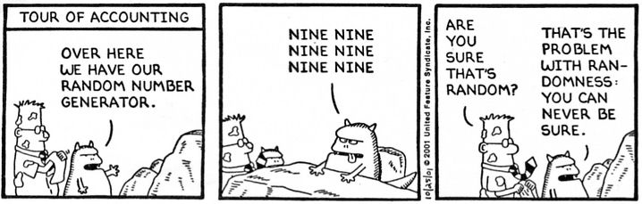
End comment
How can we tell that a deck is well shuffled?

Slide 45
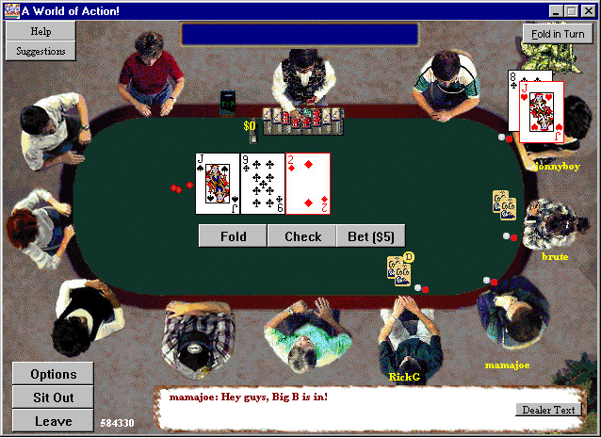
End comment
How PlanetPoker.com went broke:
In on-line poker, the card shuffling is done by the game software.
PlanetPoker.com used a naïve shuffling algorithm.
Clever players learned to exploit the weakness, and the company went under.
The article
Notes:
Other problems when playing online poker: corrupt casino, collusion among opponents, malicious player can intercept network traffic (if not encrypted).
You don't need to know much about the details of poker: all you have to know is the cards of all of your opponents...

Slide 46
Introduction to Computer Science
Reichman University
Lecture 4-2
Arrays, Part II
Arrays in action: Application Examples
Notes:
46

